Slide 1
Benchmarking

Slide 2


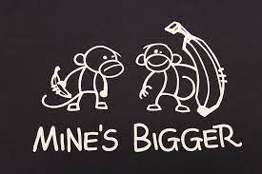
Benchmarking: Big Fan of Metrics (EMNLP)
Clichés
Lack of Substance
Whatever you measure, you get
Be careful what you ask for
It’s difficult to make predictions, especially about the future
Yogi Berra
SOTA-Chasing
Pointless Mindless Metrics
(The point should be to make progress on a real problem)
Experimental Psychology
Validity
Reliability

Slide 3
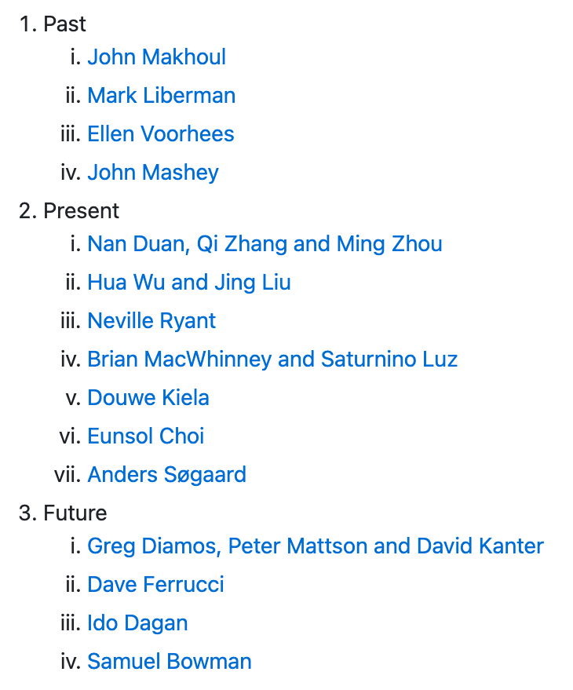

Benchmarking: Extrapolation: Past → Future
ACL-2021 Workshop
Benchmarking:
Past, Present and Future
https://github.com/kwchurch/Benchmarking_past_present_future

Slide 4
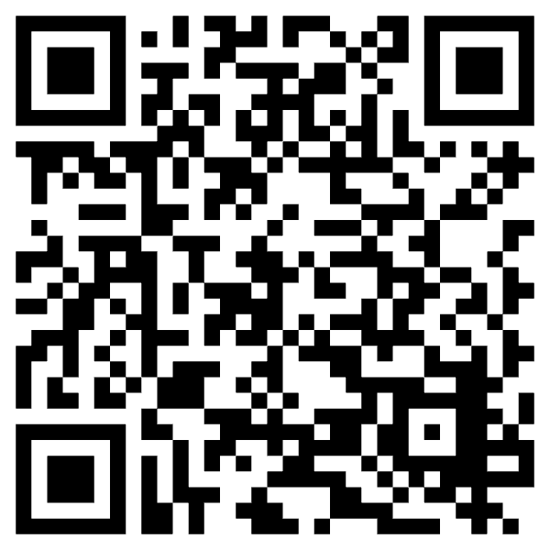
Better Together: Text + Context
https://www.semanticscholar.org/api-gallery/better-together

Slide 5
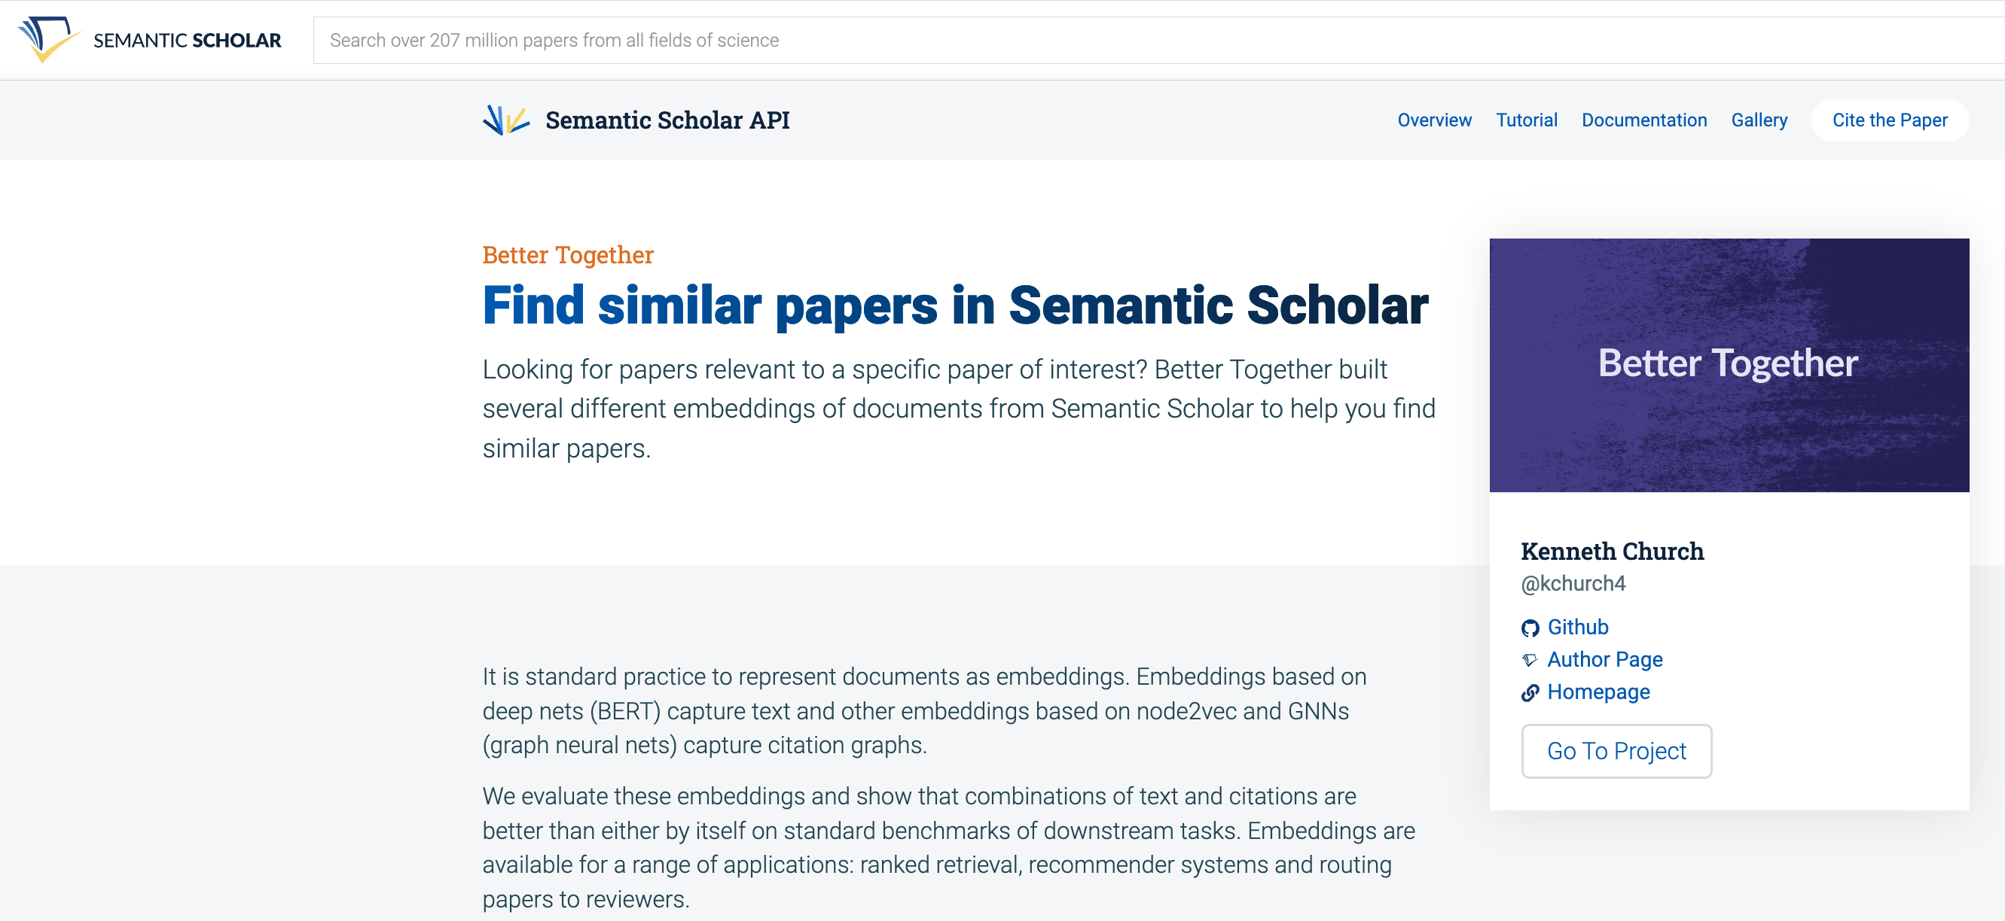
https://www.semanticscholar.org/product/api/gallery
click here

Slide 6

<return>

Slide 7

Better Together: Text (Titles, Abstracts, Body); Context (Citations)
BERT-like Deep Nets
ProNE:
Spectral Clustering

Slide 8
Opportunity: More Realistic Benchmarks
The Real World
Idealizations (Standard Benchmarks)
Large (Metcalfe’s Law)
Growing
Dirty
Missing Values
Bad/misleading Values
Small
Static
Clean

Slide 9
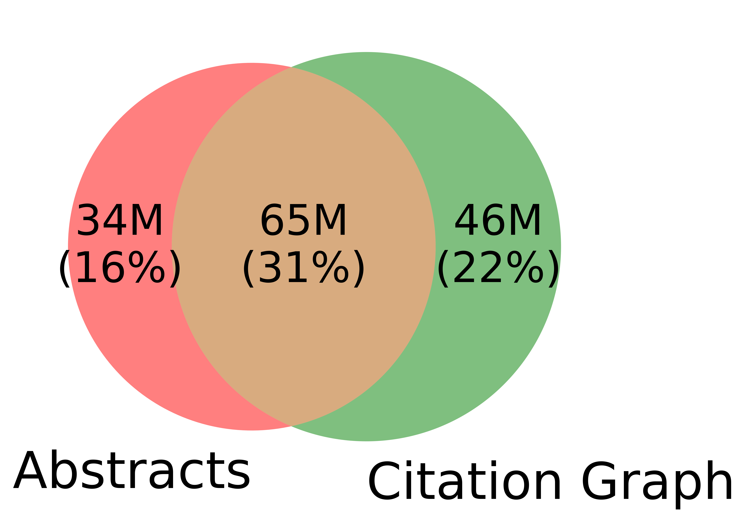
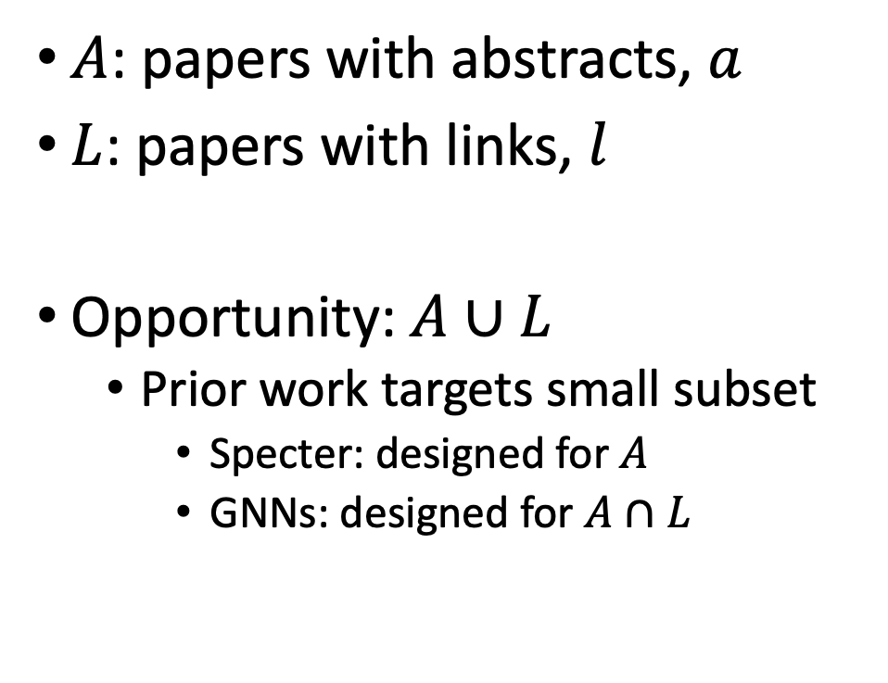
Realities (Dirty): Missing Values
$A$: papers with abstracts, $a$
$L$: papers with links, $l$
Opportunity:$A∪L$
Prior work targets small subset
Specter: designed for $A$
GNNs: designed for $A∩L$
Other
31%

Slide 10


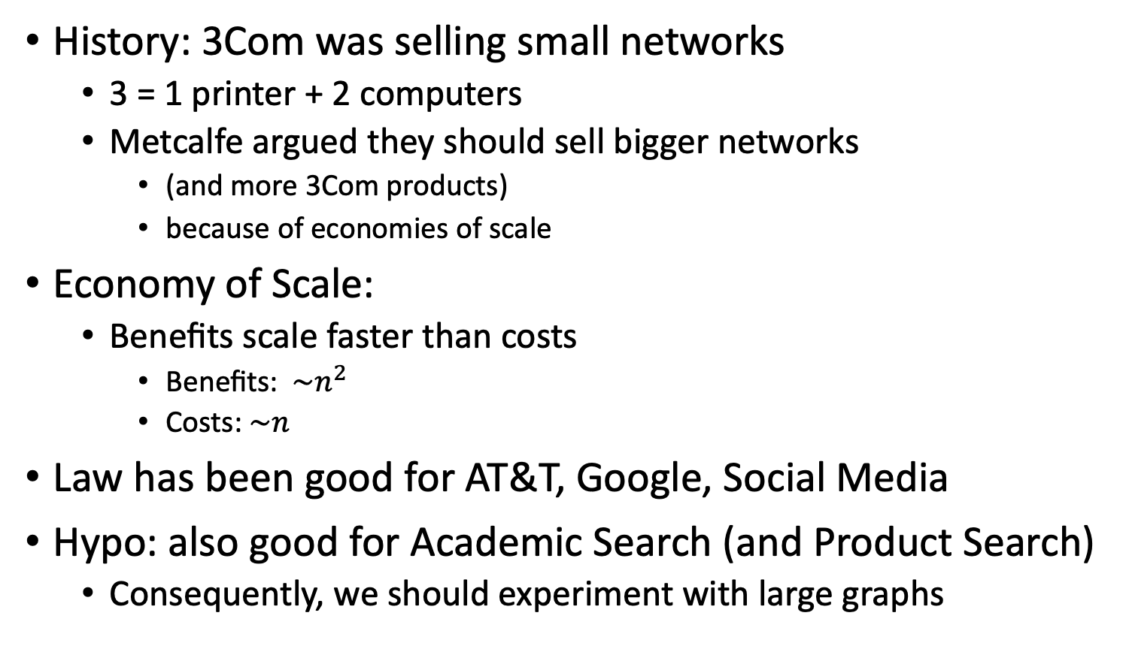
Metcalfe’s Law (Network Effects)
History: 3Com was selling small networks
3 = 1 printer + 2 computers
Metcalfe argued they should sell bigger networks
(and more 3Com products)
because of economies of scale
Economy of Scale:
Benefits scale faster than costs
Benefits: $\sim n^{2}$
Costs:$\sim n$
Law has been good for AT&T, Google, Social Media
Hypo: also good for Academic Search (and Product Search)
Consequently, we should experiment with large graphs

Slide 11
Better-Together Conjectures
Multiple representations are helpful
for missing values (and bad values)
If abstracts are missing, use links
If links are missing, use abstracts
and for graphs of different sizes
When graphs are small:
Text >> Links
when graphs are large:
Links >> Text (Metcalfe’s Law)

Slide 12
Opportunities
Scale
Prediction
Many benchmarks return a single number (figure of merit)
How does performance scale
with the size of the problem?
Standard test/train splits
More relevant to interpolation
than extrapolation
Time is asymmetric
It is difficult to make predictions
especially about the future
-- Yogi Berra

Slide 13
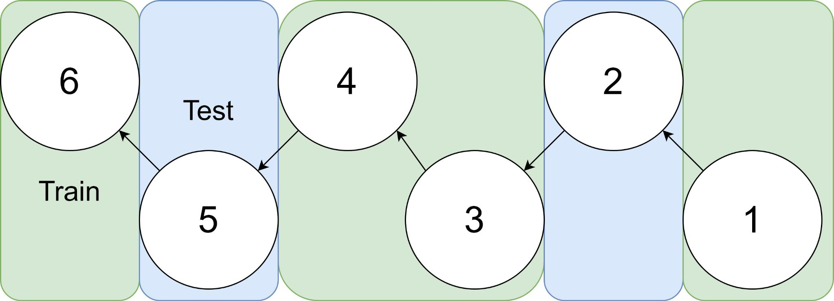
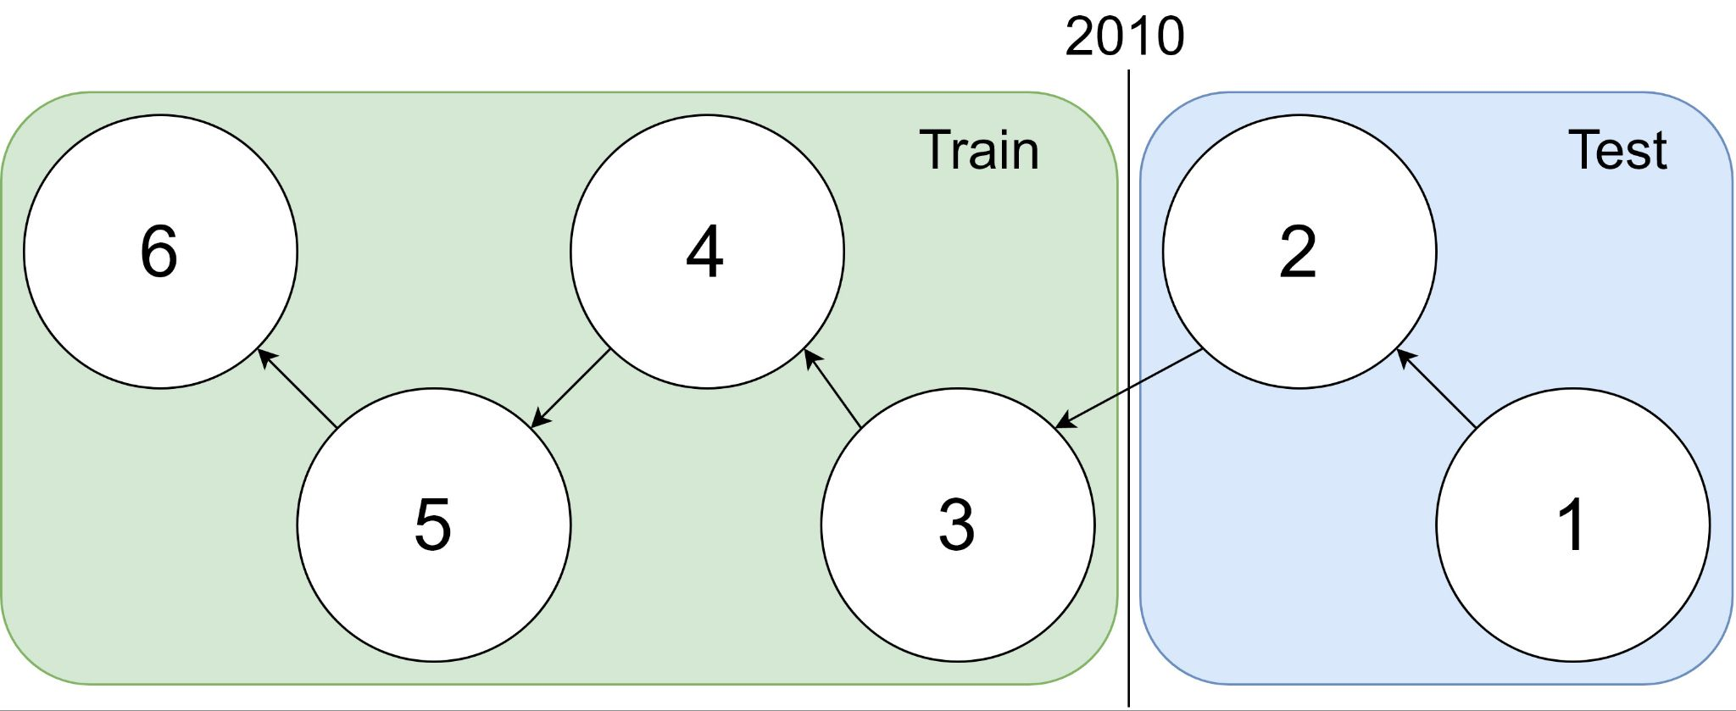
Example: 1 cites 2, 2 cites 3, … 5 cites 6
Traditional Train-Test Split (Non-Causal)
idx | Pub Year | Paper Title
1 | 2018 | [...] Photofragment imaging
2 | 2016 | Convenient probe of S(1D2)[...]
3 | 2005 | Megapixel ion imaging [...]
4 | 2003 | Direct current slice imaging [...]
5 | 1995 | profiles of Cl(2Pj) photofragments [...]
6 | 1988 | Adiabatic dissociation of [...]
Proposed Train-Test Splits (Causal)
Notes:
No asymmetry of time - how to reduce to a soundbite
Audience soundbites
‘Almost all studies in ml do test-train split’ that’s a bad idea when you have time

Slide 14
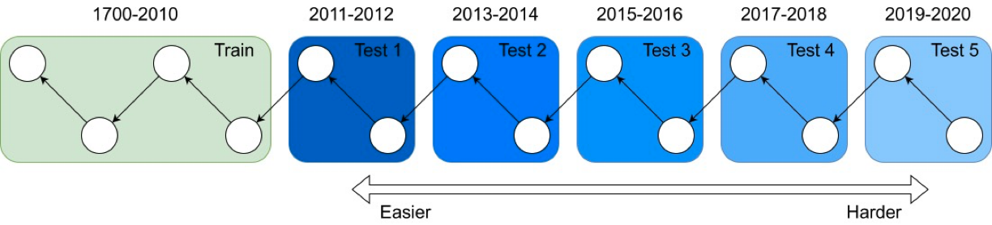
It's tough to make predictions, especially about the future ― Yogi Berra
Forecasting: short-term predictions are easier than long-term

Slide 15
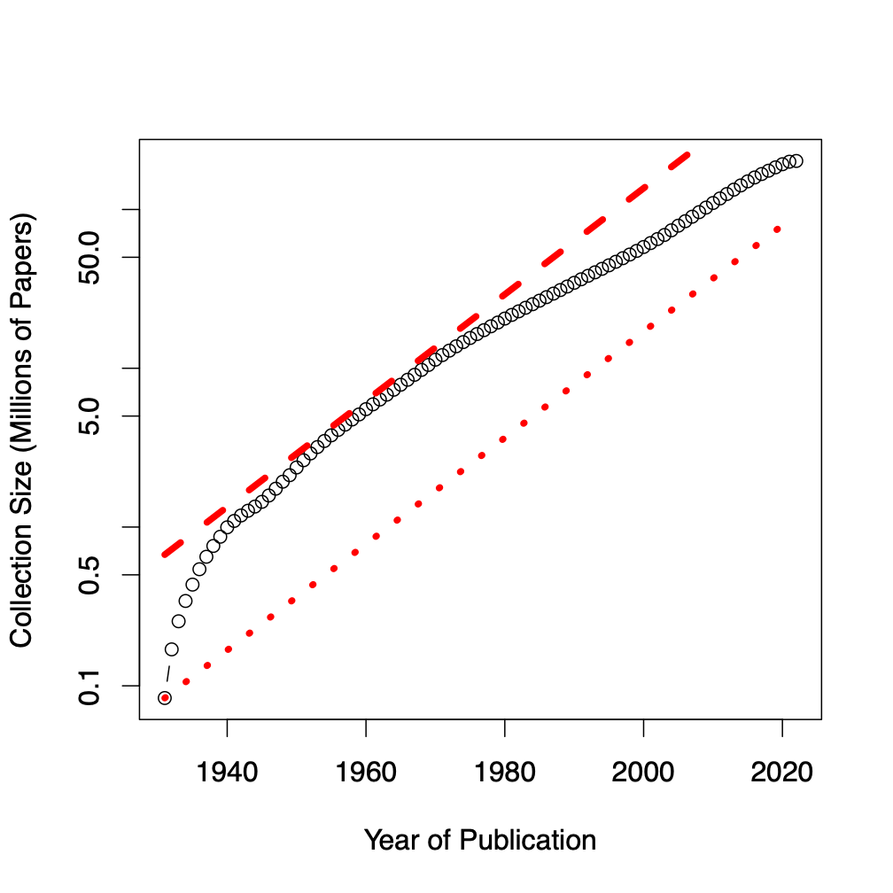
Assign 200M papers to 100 bins (by time)
Sort 200M papers by publication date
Output: Split papers into 100 bins, with 2M papers/bin
Because of exponential growth
(literature doubles every 9 years)
older bins span more time, and
newer bins span less time
Bin 99
………
Bin 0
Time
Notes:
mention equal # papers
consider replacing w/ diagram

Slide 16
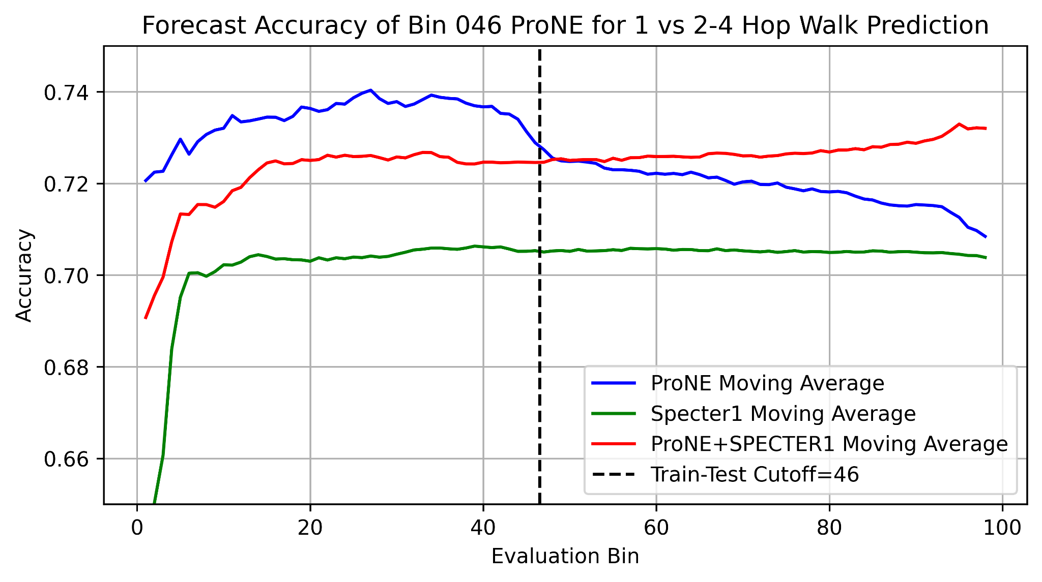
Better Together Observations
ProNE (Context) >> Specter (Text)
Ensembles are better
than either by itself
Text is most helpful
when links are not working well
i.e., long-term forecasting

Slide 17
Benchmarking Take-Aways More Realistic Benchmarks
The Real World
Idealizations (Standard Benchmarks)
Large (Metcalfe’s Law)
Growing
Dirty
Missing Values
Bad/misleading Values
Small
Static
Clean

Slide 18
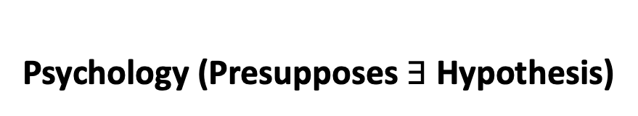
Two Perspectives on Datasets
Machine Learning
Psychology (Presupposes $∃$Hypothesis)
Splits: train/val/test
Treat rows as iid
Identical and independently distributed
Idealistic, but maybe unrealistic
Changes over time, Context, etc.
More papers on models
than Datasets
Relatively little interest in
Is the Dataset Realistic?
Motivation? (Does anyone care? If so, who?)
What is the dataset testing?
Sampling/balance? From which population?
Can it be gamed? Leakage?
Validity
Content validity
Construct validity
Criterion validity
Face validity
Discriminant validity
Reliability
Inter-rater reliability
Test-retest reliability
Internal reliability/Inter-item consistency
Split half reliability
Lexicography

Slide 19
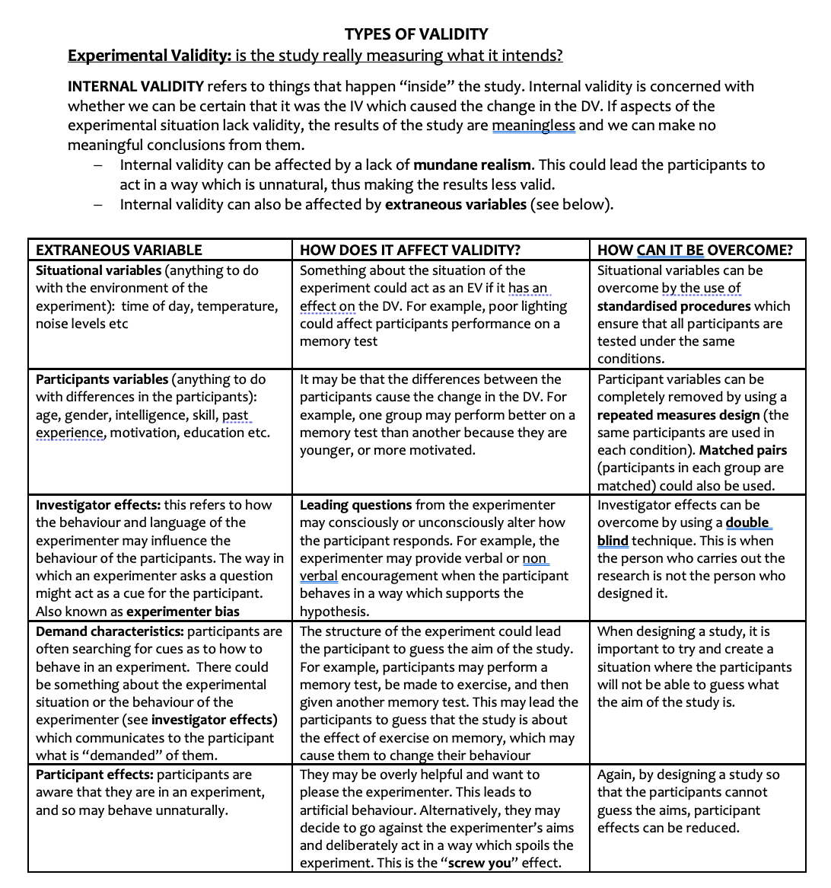
Discussion of Validity Assumes: Intention

Slide 20
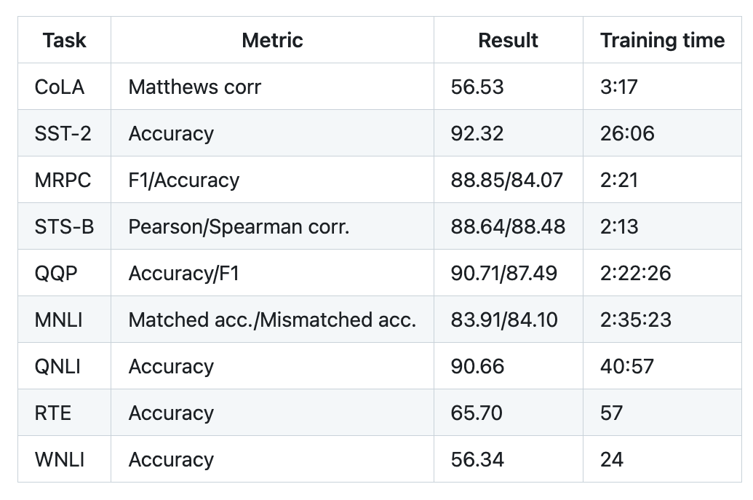
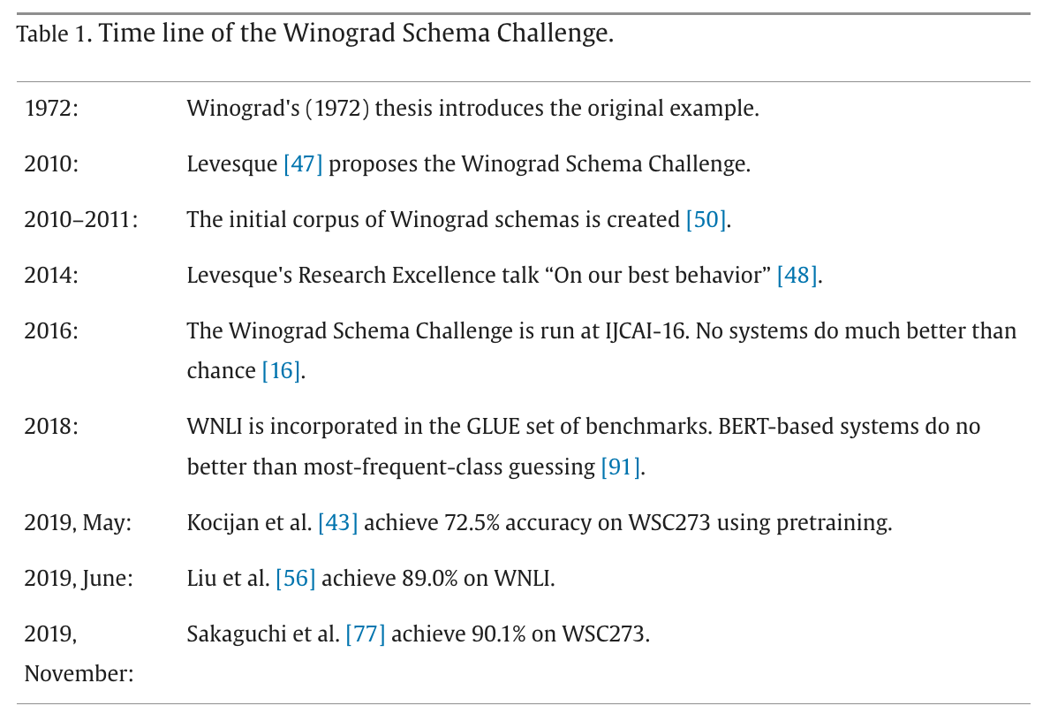
Winograd Schema (GLUE WNLI)
The trophy doesn't fit in the brown suitcase
because it is too large.
What is too large?
A. The trophy
B. The suitcase
Not much better than chance
from: https://doi.org/10.1016/j.artint.2023.103971

Slide 21
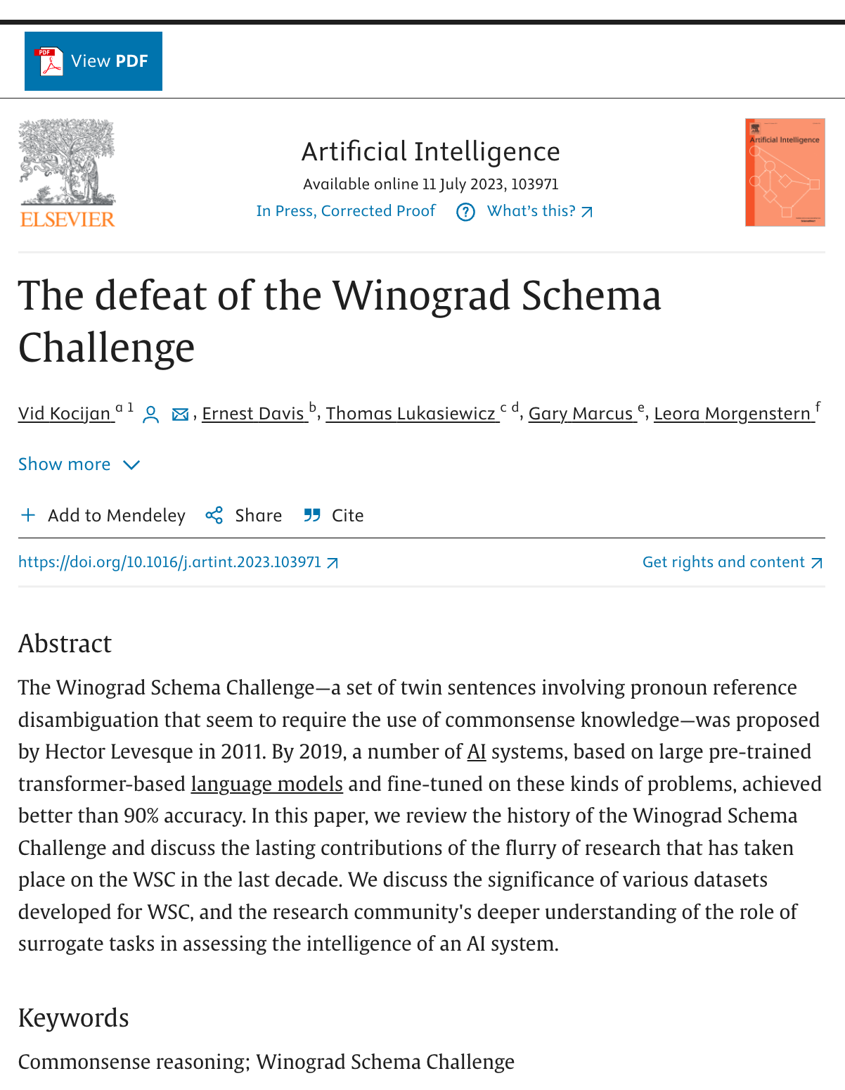
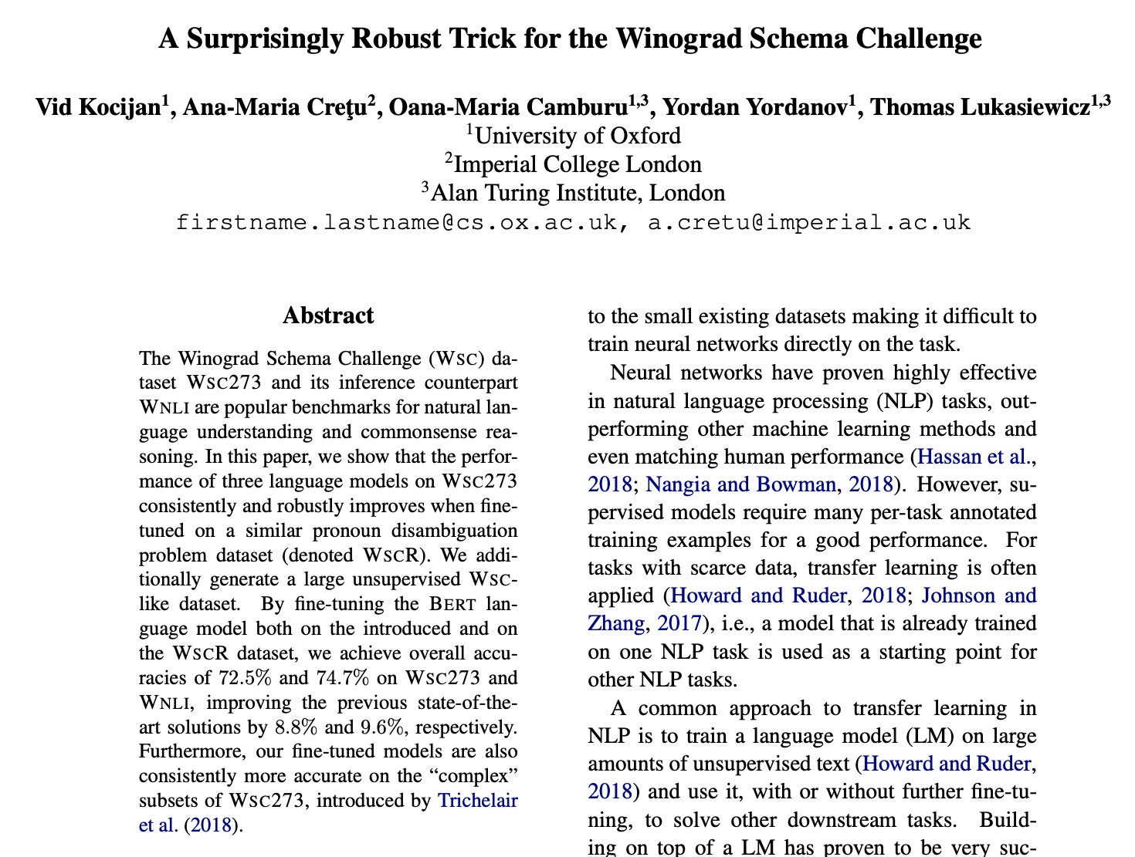
Winograd Schema (GLUE WNLI)

